Slide 1
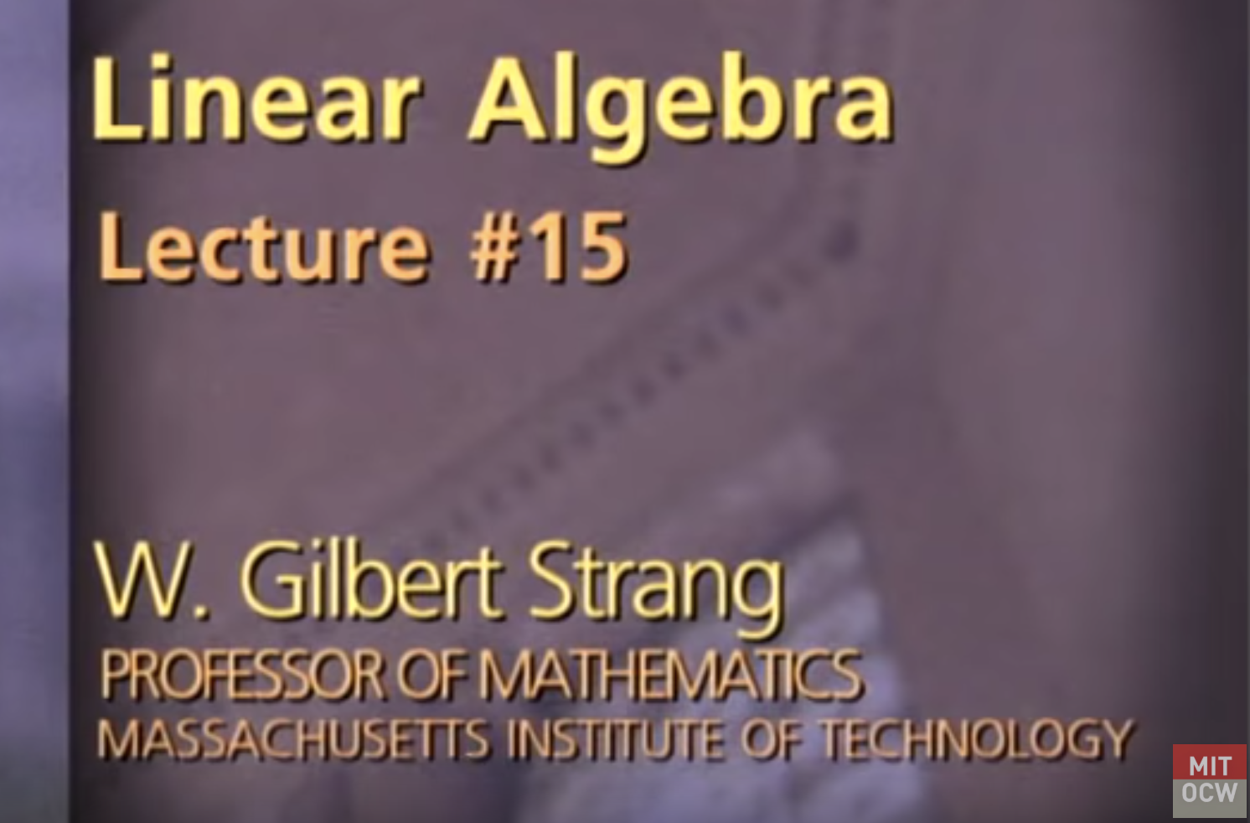
Linear Algebra – Lecture #15 Projections onto subspaces
By Ariel Guerrero
ariel.guerrero@uc.edu.py
+595 (981) 425 040

Slide 2
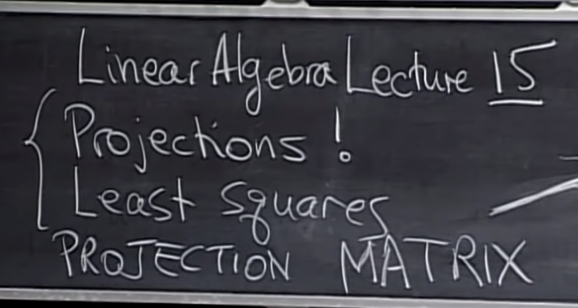
Linear Algebra Lecture 15

Slide 3
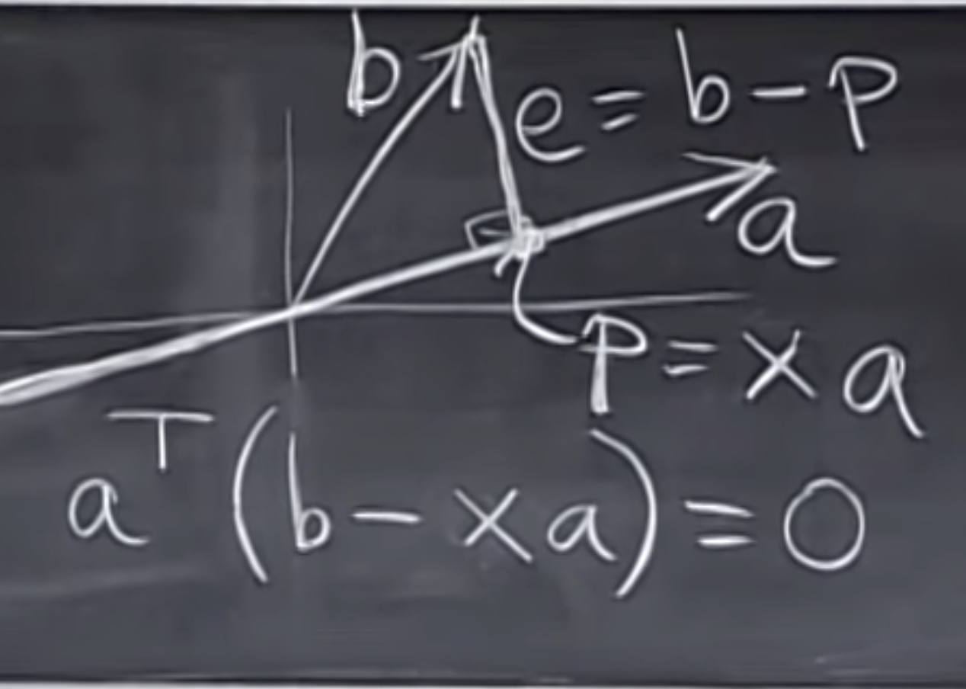
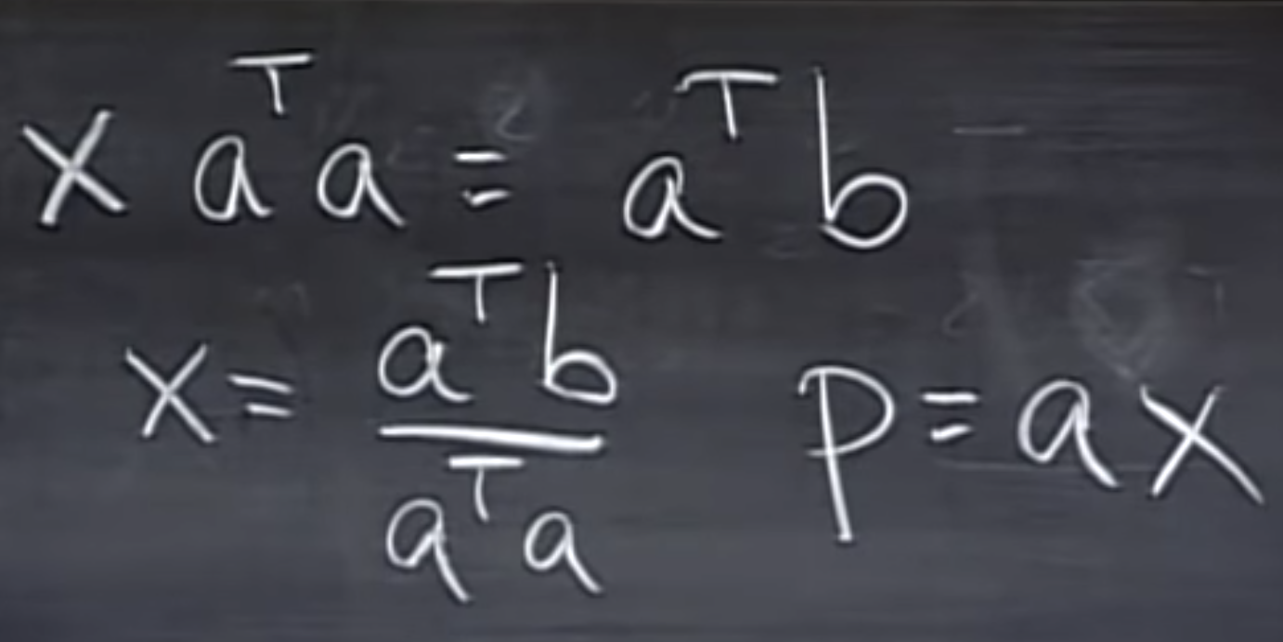
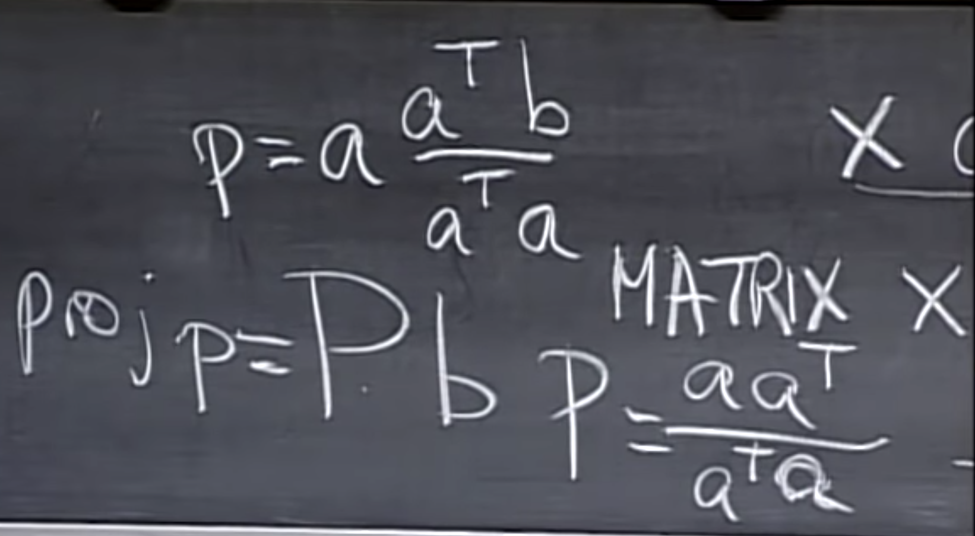
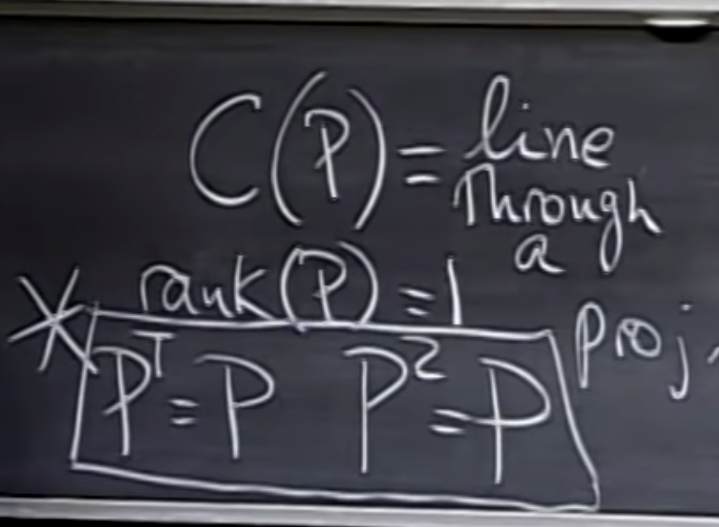
Projections into a line
Notes:
https://www.youtube.com/watch?v=Y_Ac6KiQ1t0
To timeframe of video 15:39

Slide 4
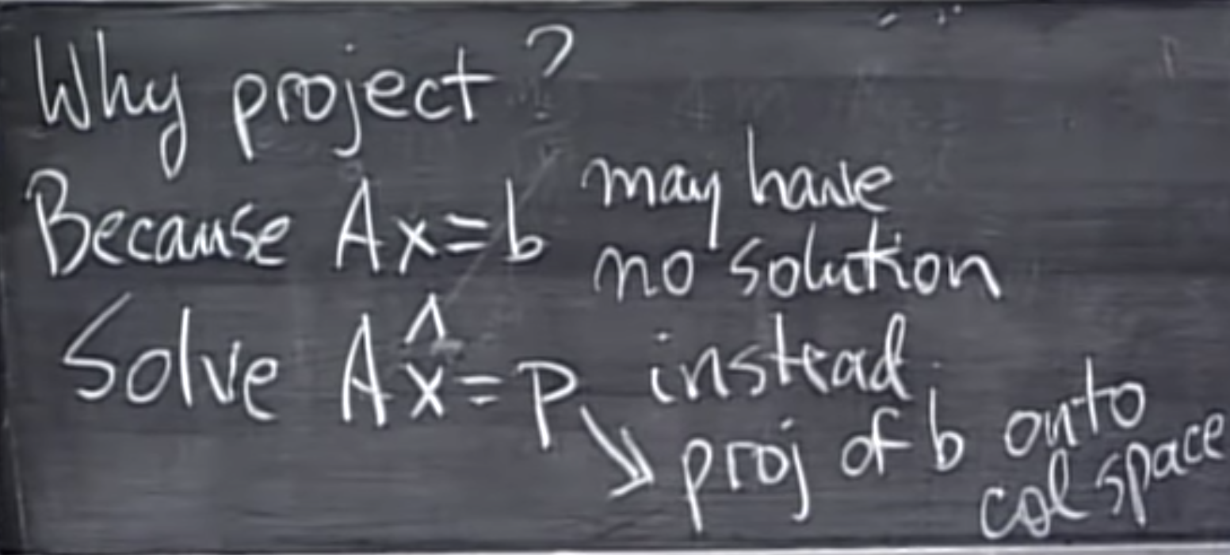
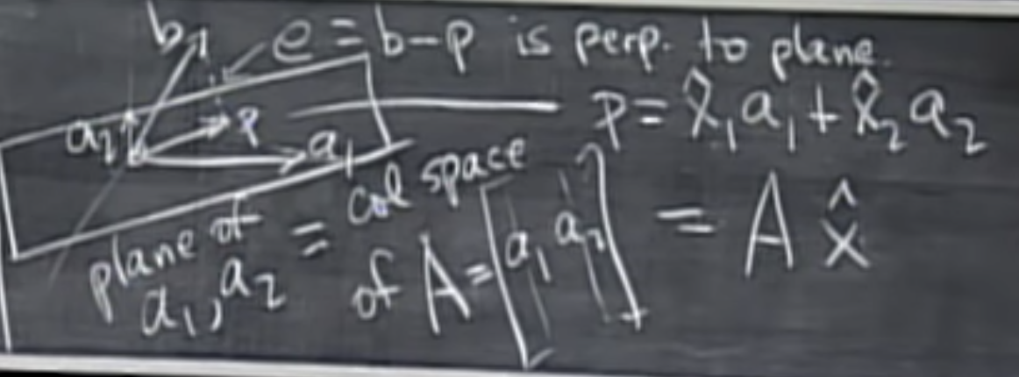
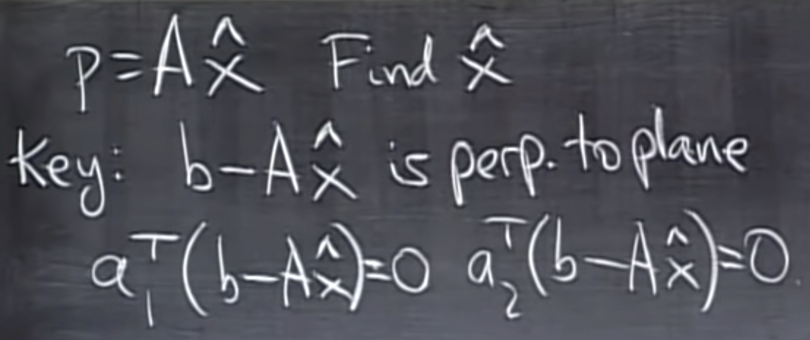
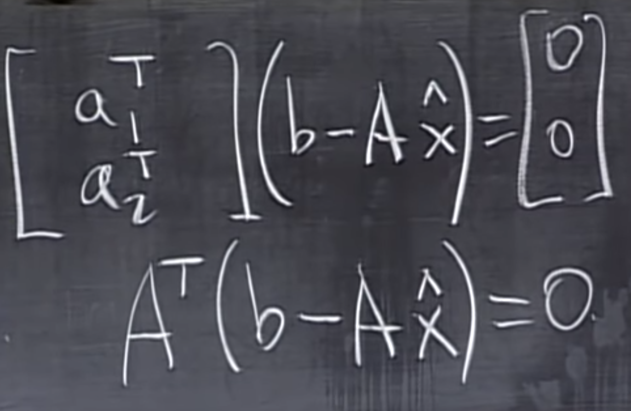
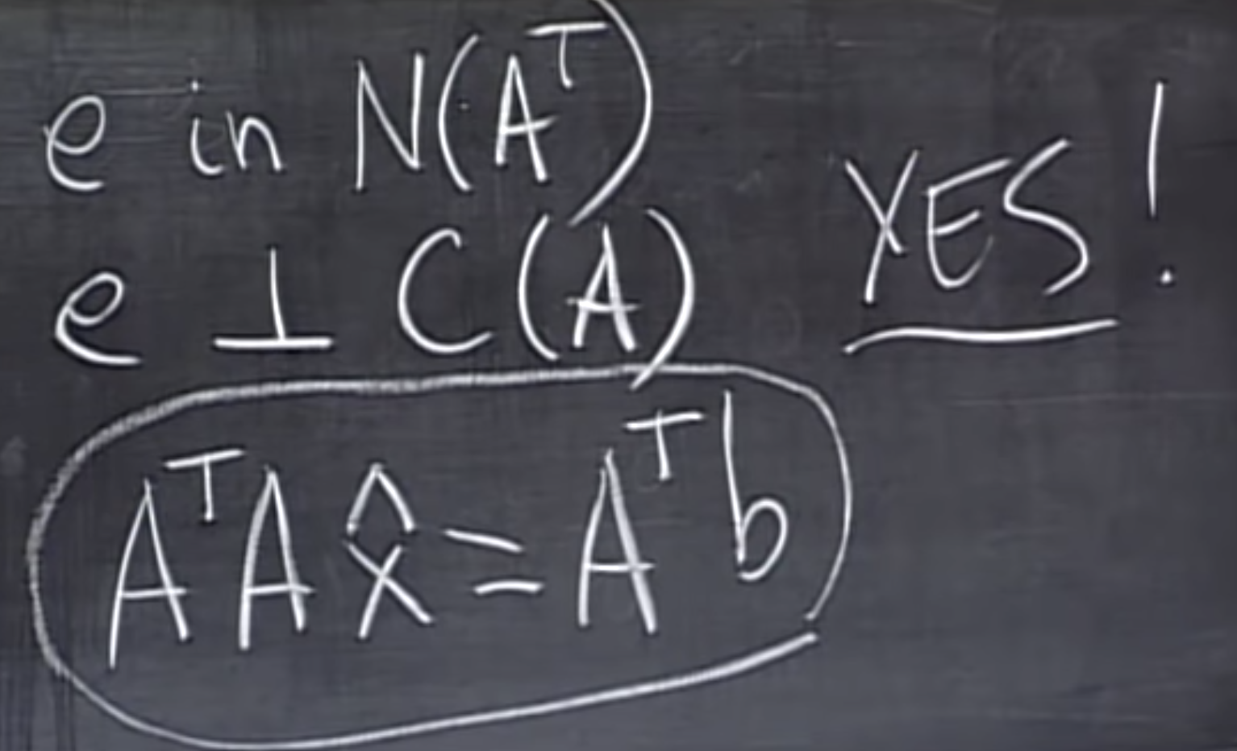
Projections into a subspace
Notes:
https://www.youtube.com/watch?v=Y_Ac6KiQ1t0
To timeframe of video 15:39 to 33:24

Slide 5
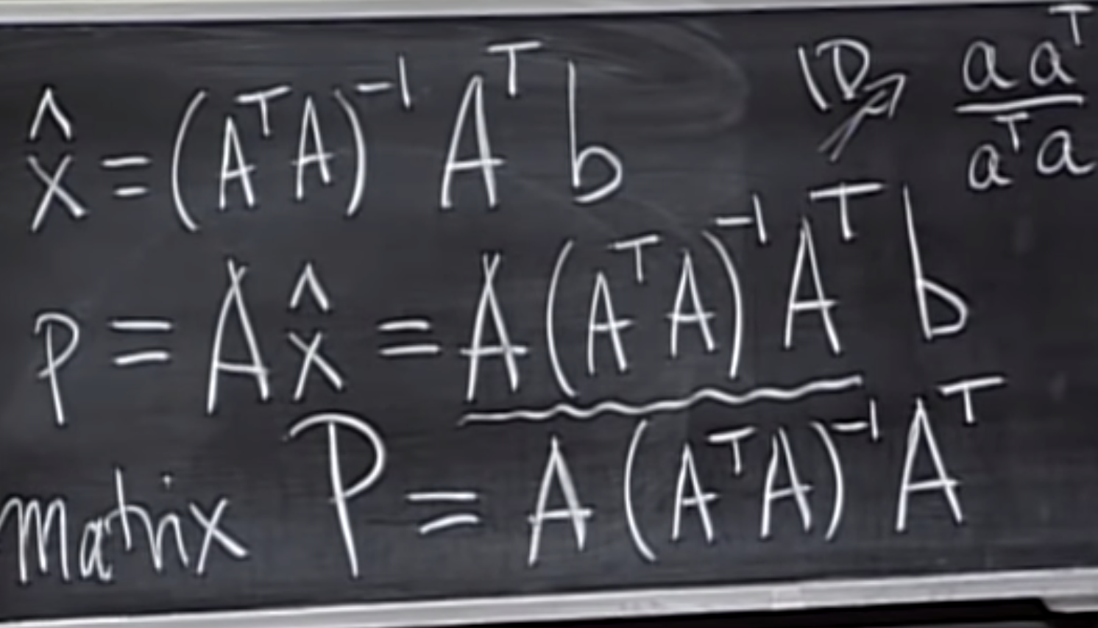
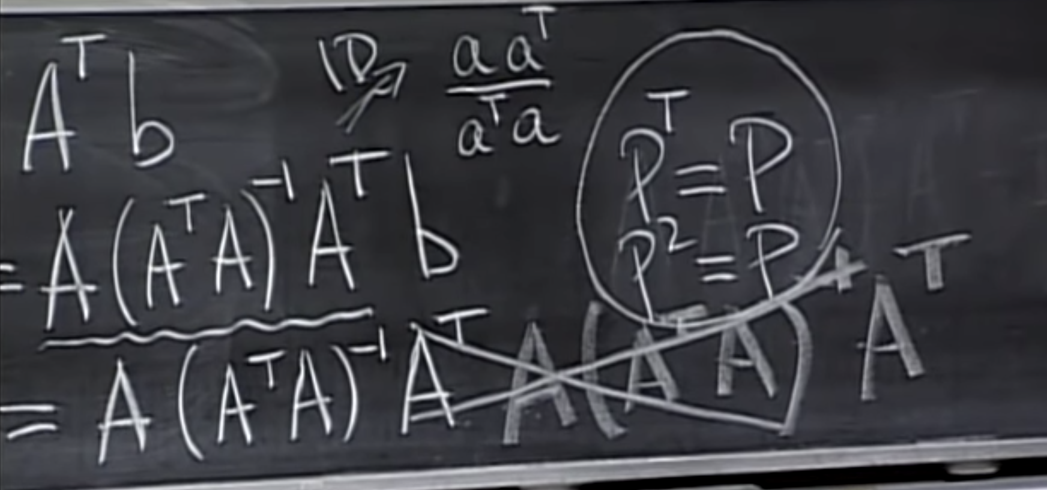
Projections into a subspace
Notes:
https://www.youtube.com/watch?v=Y_Ac6KiQ1t0
To timeframe of video 33:24 to
IF A is not square (A^T A)^-1 dosn’t have inverse

Slide 6
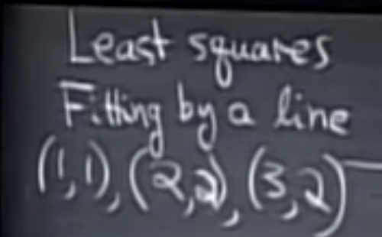
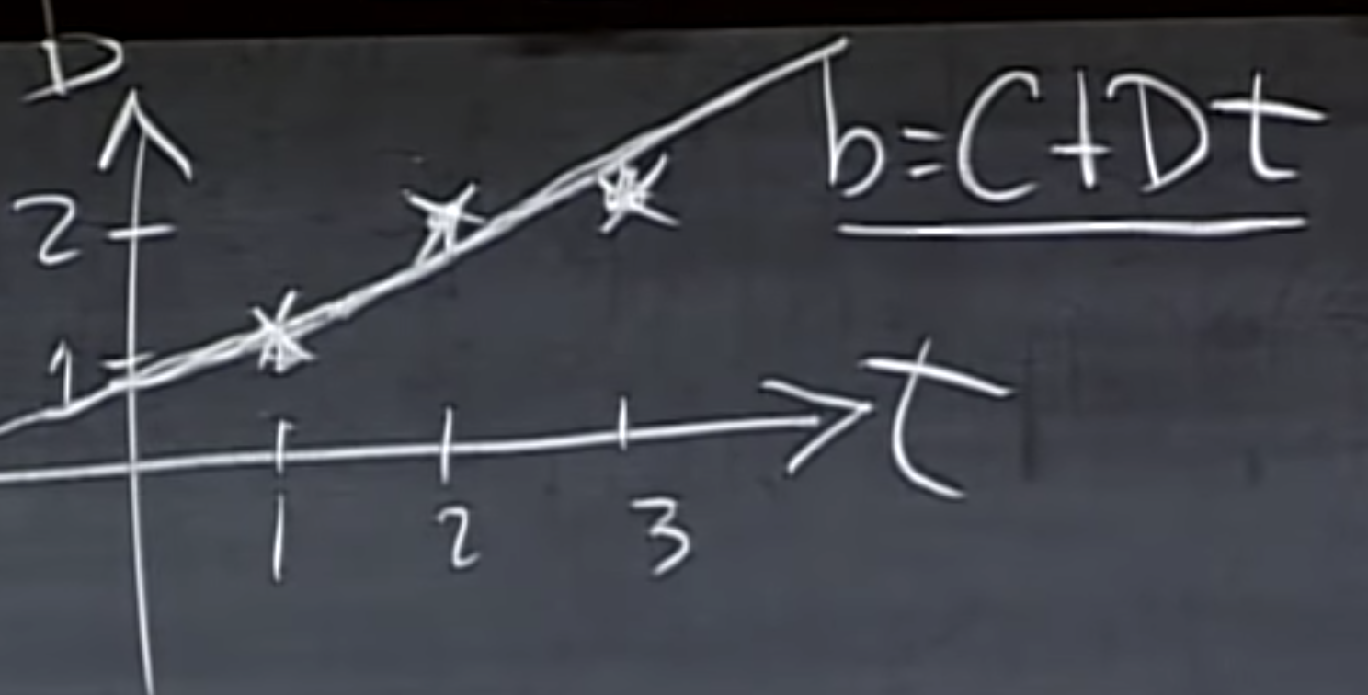
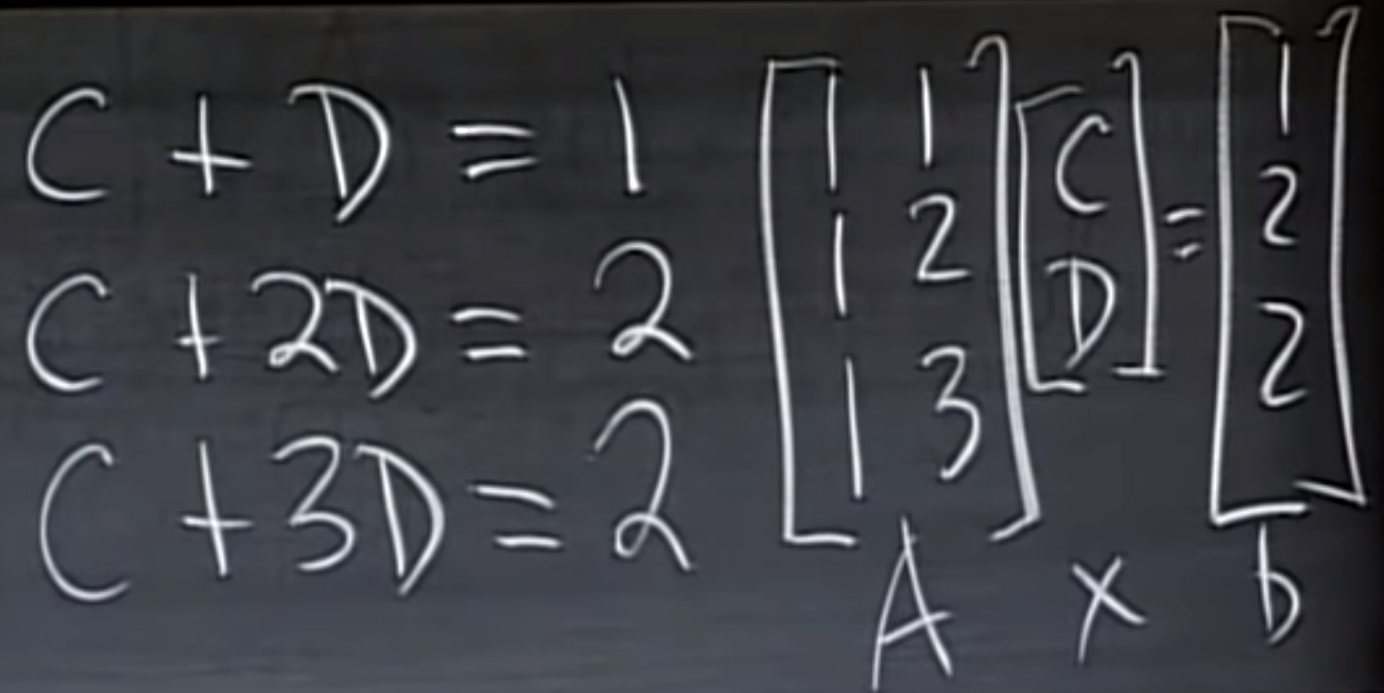
Least square fitting by a line
The video ends with the problem statement
Notes:
https://www.youtube.com/watch?v=Y_Ac6KiQ1t0 the video ends with the problem statement

Slide 7
Credits
https://github.com/aegiloru/linearAlgebra
https://ocw.mit.edu/courses/mathematics/18-06-linear-algebra-spring-2010/index.htm
Gilbert Strang Web Site
http://www-math.mit.edu/~gs/
http://math.mit.edu/~gs/linearalgebra/

Slide 8
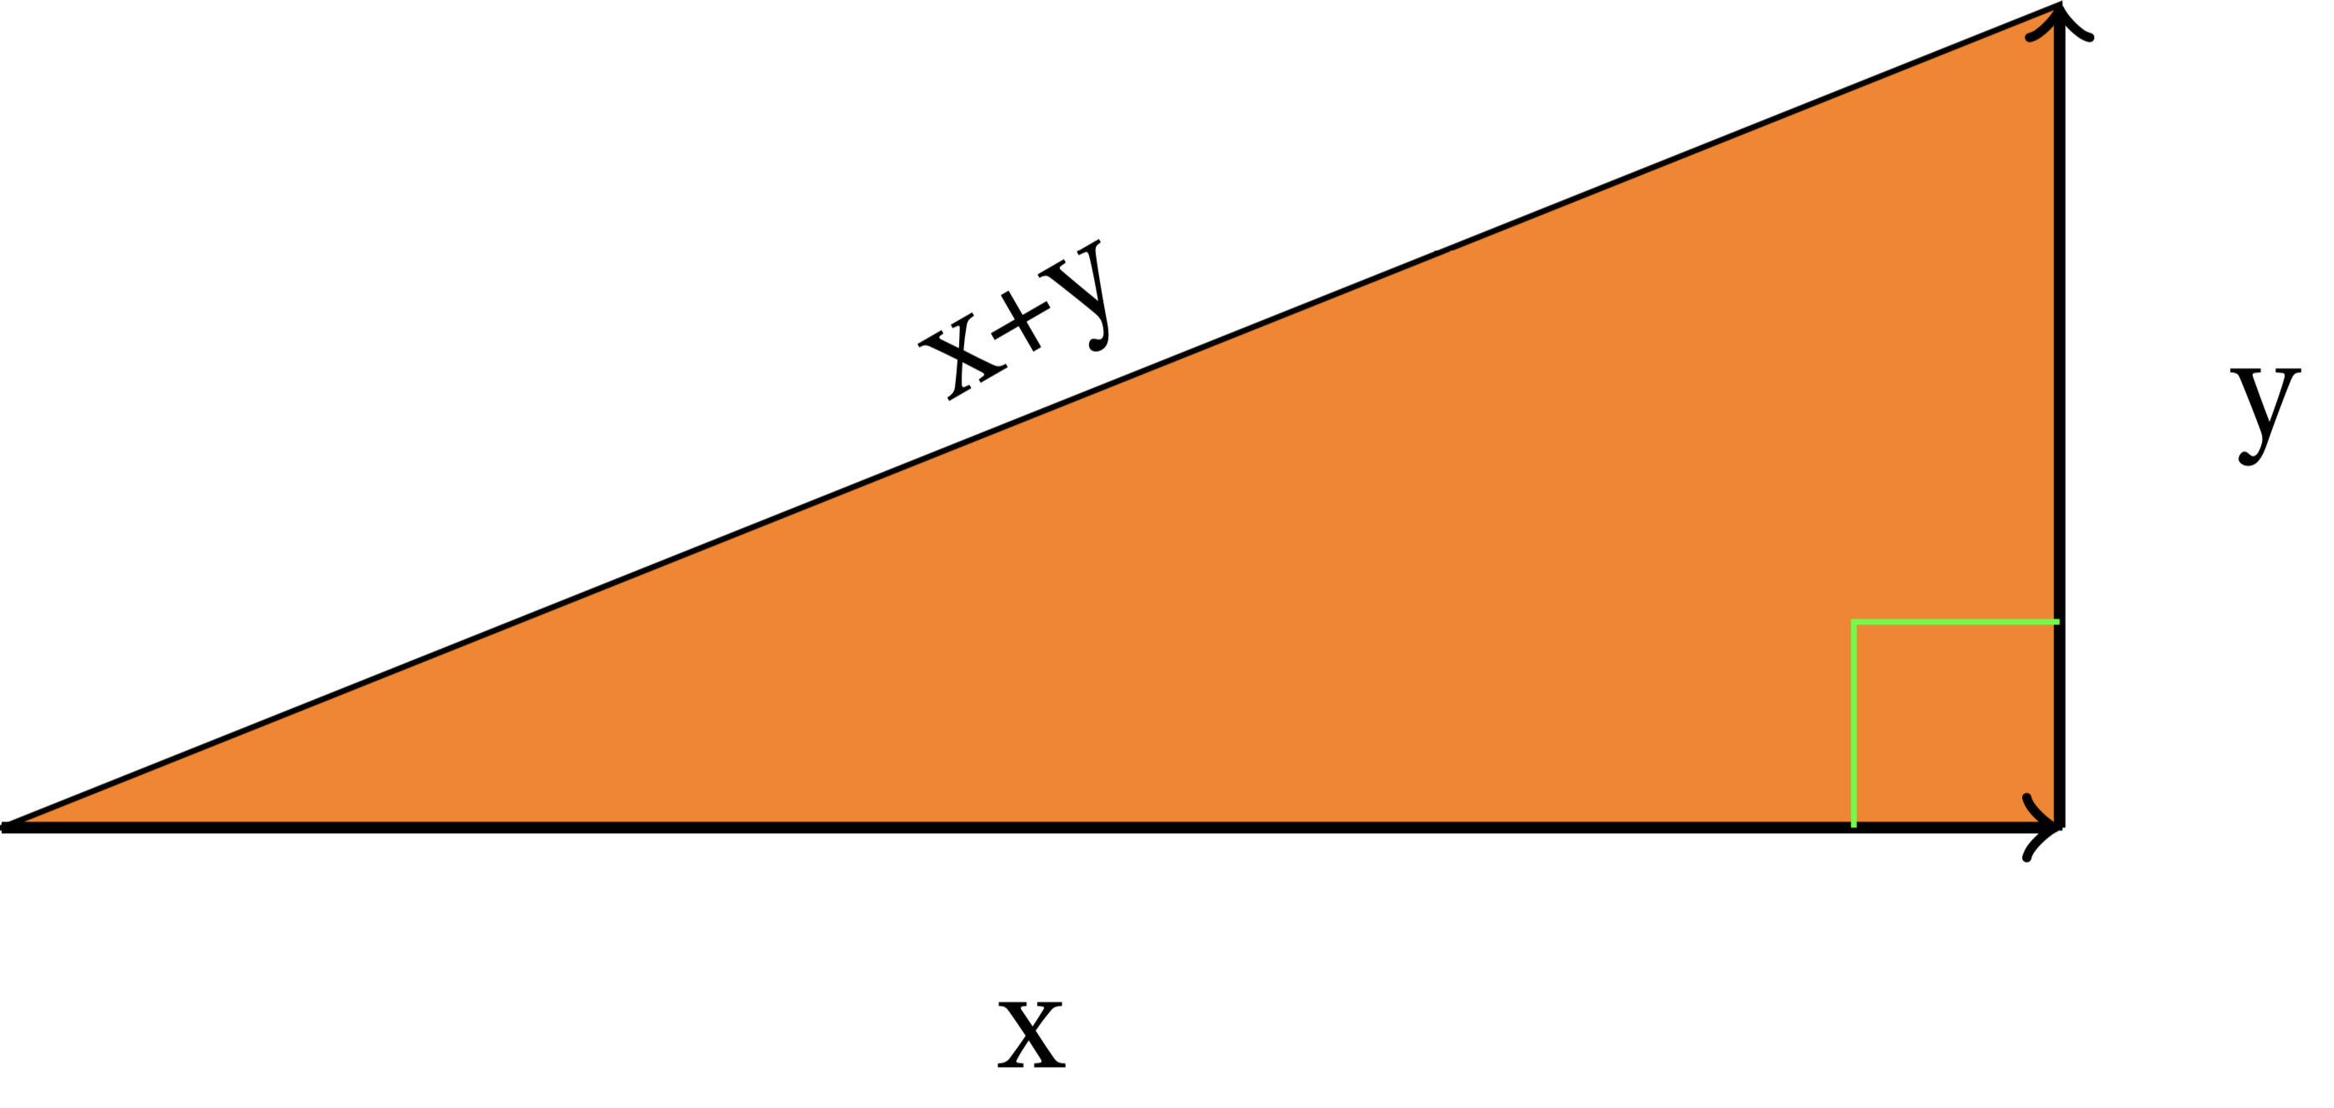

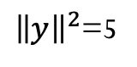
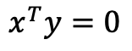
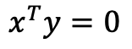
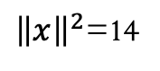
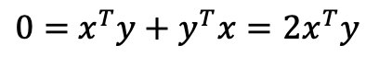
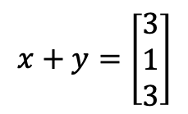
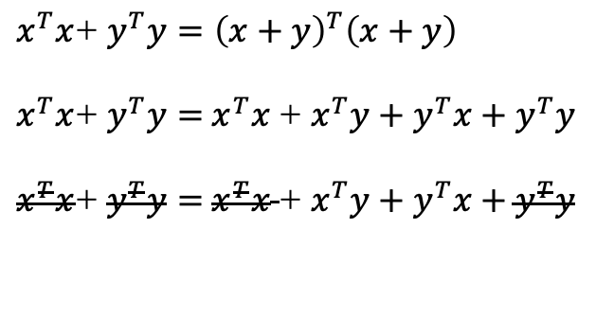
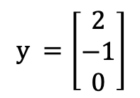
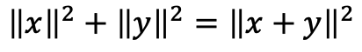
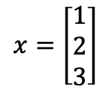
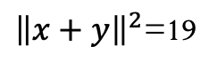
Orthogonal Vectors
$$x^{T}y=0$$
$${\left\|x\right\|}^{2}+{\left\|y\right\|}^{2}={\left\|x+y\right\|}^{2}$$
Pythagoras
$x^{T}x$+ $y^{T}y={\left(x+y\right)}^{T}\left(x+y\right)$
$x^{T}x$+ $y^{T}y=$ $x^{T}x$ + $x^{T}y+y^{T}x+y^{T}y$
$x^{T}x$+ $y^{T}y=$ $x^{T}x$ + $x^{T}y+y^{T}x+y^{T}y$
$$x=\left[\begin{matrix}1 \\ 2 \\ 3\end{matrix}\right]$$
$$y =\left[\begin{matrix}2 \\ −1 \\ 0\end{matrix}\right]$$
$$x+y=\left[\begin{matrix}3 \\ 1 \\ 3\end{matrix}\right]$$
$0=$ $x^{T}y+y^{T}x=2x^{T}y$
${\left\|x\right\|}^{2}$=14
${\left\|y\right\|}^{2}$=5
${\left\|x+y\right\|}^{2}$=19
Then
$$x^{T}y=0$$
$$∎$$
Q.E.D.

Slide 9
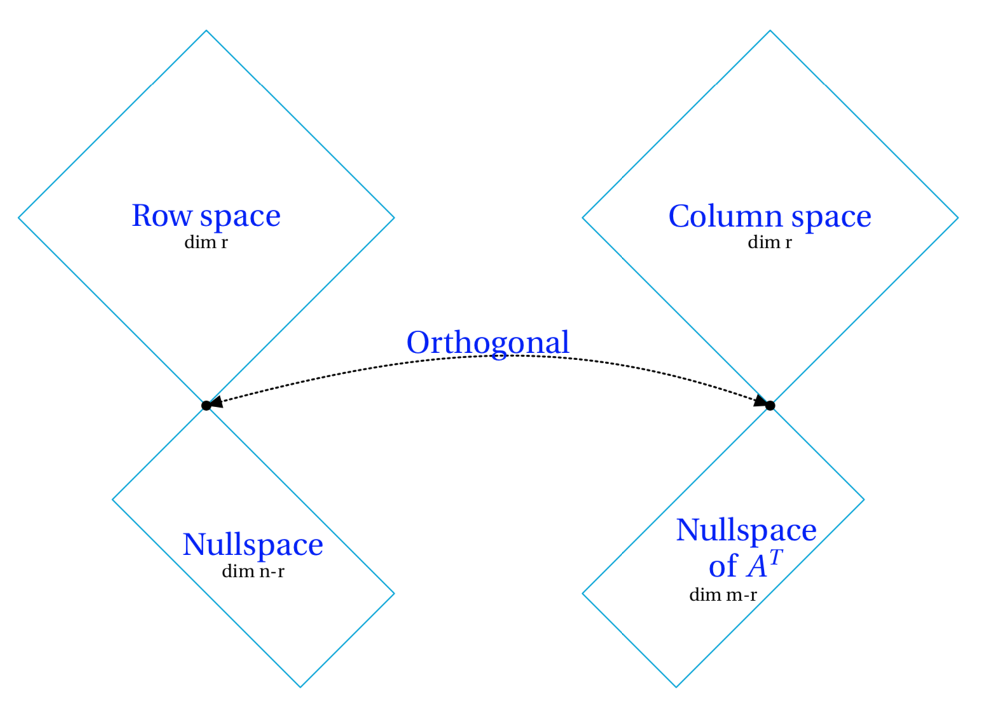
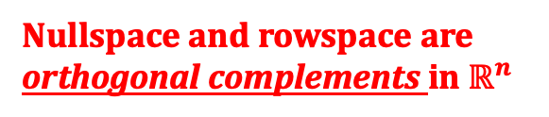
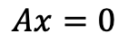
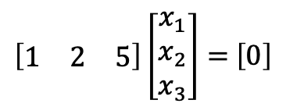
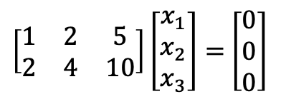
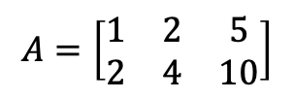
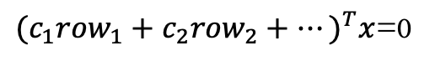
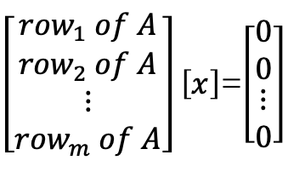
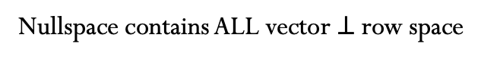
Subpace S is orthogonal to Subspace T
Means:
Row space is orthogonal
to nullspace
Every vector in S is orthogonal to every vector in T
Why?
$$Ax=0$$
$\left[\begin{matrix}{row}_{1} of A \\ {row}_{2} of A \\ \begin{matrix}⋮ \\ {row}_{m} of A\end{matrix}\end{matrix}\right]\left[x\right]$=$\left[\begin{matrix}0 \\ 0 \\ \begin{matrix}⋮ \\ 0\end{matrix}\end{matrix}\right]$
In the row space also it’s the linear combination
of row_{i}
$$A=\left[\begin{matrix}1 & 2 & 5 \\ 2 & 4 & 10\end{matrix}\right]$$
n=3, r=1
${{(c}_{1}{row}_{1}+c_{2}{row}_{2}+⋯)}^{T}x$=0
Dim N(A) = 2
$\left[\begin{matrix}1 & 2 & 5 \\ 2 & 4 & 10\end{matrix}\right]\left[\begin{matrix}x_{1} \\ x_{2} \\ x_{3}\end{matrix}\right]=$ $\left[\begin{matrix}0 \\ 0 \\ 0\end{matrix}\right]$
Nullspace and rowspace are
orthogonal complements in $ℝ^{n}$
$\left[\begin{matrix}1 & 2 & 5\end{matrix}\right]\left[\begin{matrix}x_{1} \\ x_{2} \\ x_{3}\end{matrix}\right]=$ $\left[0\right]$
Nullspace contains ALL vector $⊥$row space

Slide 10
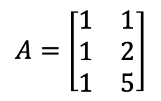

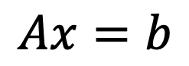

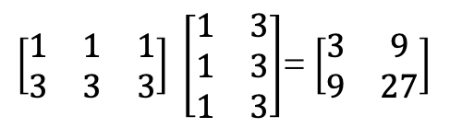
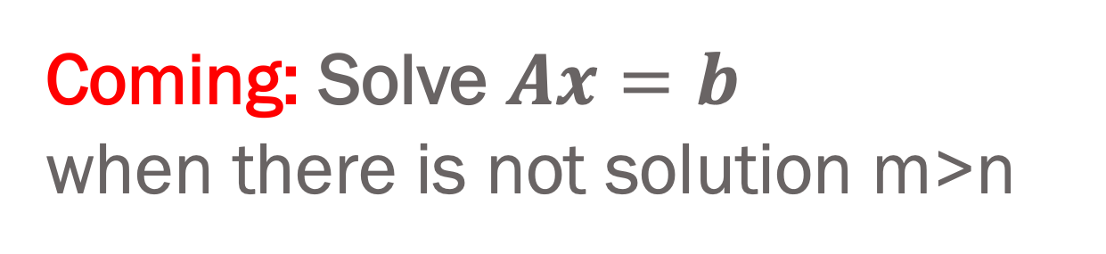
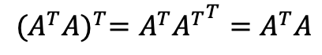
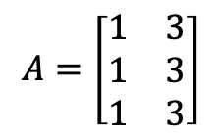
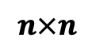
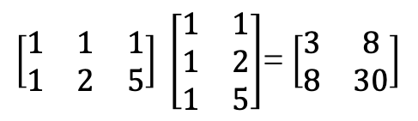
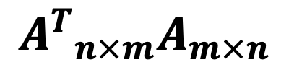
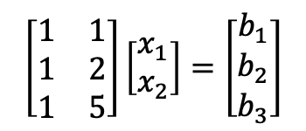
Coming: Solve $Ax=b$ when there is not solution m>n
$${A^{T}}_{n×m}A_{m×n}$$
$$Ax=b$$
$$n×n$$
$$A^{T}A\hat{x}=A^{T}b$$
symmetric
$${(A^{T}A)}^{T}=A^{T}{A^{T}}^{T}=A^{T}A$$
$$A=\left[\begin{matrix}1 & 1 \\ 1 & 2 \\ 1 & 5\end{matrix}\right]$$
$$\left[\begin{matrix}1 & 1 \\ 1 & 2 \\ 1 & 5\end{matrix}\right]\left[\begin{matrix}x_{1} \\ x_{2}\end{matrix}\right]=\left[\begin{matrix}b_{1} \\ b_{2} \\ b_{3}\end{matrix}\right]$$
$\left[\begin{matrix}1 & 1 & 1 \\ 1 & 2 & 5\end{matrix}\right] \left[\begin{matrix}1 & 1 \\ 1 & 2 \\ 1 & 5\end{matrix}\right]$= $\left[\begin{matrix}3 & 8 \\ 8 & 30\end{matrix}\right]$
r=2
$$A=\left[\begin{matrix}1 & 3 \\ 1 & 3 \\ 1 & 3\end{matrix}\right]$$
$\left[\begin{matrix}1 & 1 & 1 \\ 3 & 3 & 3\end{matrix}\right] \left[\begin{matrix}1 & 3 \\ 1 & 3 \\ 1 & 3\end{matrix}\right]$= $\left[\begin{matrix}3 & 9 \\ 9 & 27\end{matrix}\right]$
r=1
$A^{T}A$is invertible exactly if $A$has independents columns
$${N(A}^{T}A)=N(A)$$

